Slide 1
Course: MOBI8001 - Mobile Technology and Cloud Computing
Period: March 2017
Vehicular Mobile Cloud Computing
Session 15
D5627 – I Gede Putra Kusuma Negara, B.Eng., PhD

Slide 2
Outline
Introduction
Vehicular Ad Hoc Network
Architecture and Working Model
Limitations
Challenges
Application: Safety Applications
Application: User Applications
Conclusion
Bina Nusantara University

Slide 3
Introduction
Mobile cloud computing involves the study of several mobile agents such as vehicles and robots.
All these mobile agents collaborate and interact to feel the environment, process data, propagate outputs, and mostly share resources.
In VMCC, the underutilized resources of vehicles such as storage, Internet connectivity, and computing power are shared among drivers as well as rented on the Internet for other customers/users.
VMCC is a new hybrid technology, which has a marvelous impact on road safety and traffic management as it uses instant vehicular resources such as storage, computing power, and the Internet for decision making.
Recently, vehicular ad hoc networks (VANETs) is used to yield suitable wireless network services.
Vehicles are no longer just a means of transportation; they are equipped with smartphones that have more sensing, processing, and communicating capabilities.
Bina Nusantara University

Slide 4
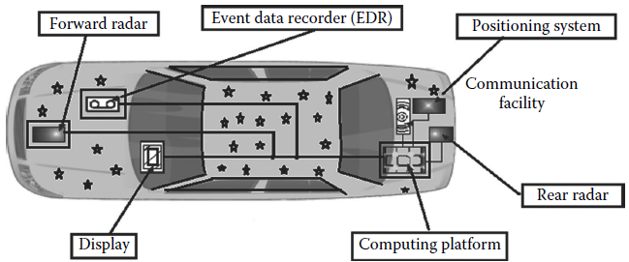
Vehicular Ad Hoc Network
VANETs are special types of vehicles equipped with digital maps, positioning systems, and wireless communication systems, which act as smart machines for safety and comfort.
Components of smart vehicle:
Bina Nusantara University

Slide 5
Vehicular Ad Hoc Network
In VANETs, mostly two types of communication take place:
  vehicle to vehicle (V2V)
  vehicle to infrastructure (V2I).
V2I is a connection between vehicles and roadside units (RSUs) that contain strong computing devices placed at several locations.
RSUs are connected with base stations.
Primarily, VANETs are used for traffic efficiency improvement and traffic safety by communicating through messages.
Hence, it results in less number of accidents and traffic jams.
Bina Nusantara University

Slide 6
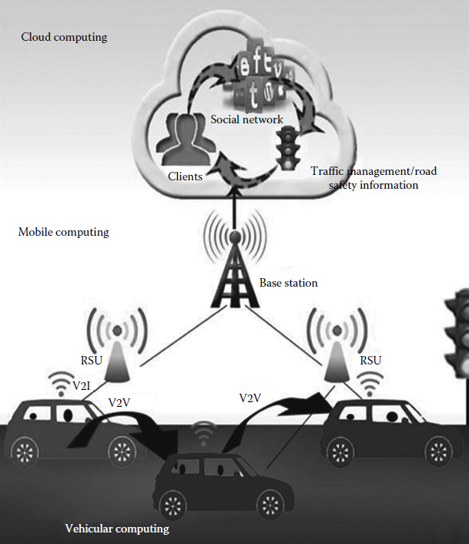
Architecture and Working Model
Three-tier VMCC
architecture:
- vehicular computing,
- mobile computing, and
- cloud computing
Bina Nusantara University

Slide 7
Architecture and Working Model
Vehicular computing layer:
  This layer consists of vehicles, RSUs, and base station.
  When the vehicles are within the range of each other, V2V communication takes place.
  When they are outside the range, they can communicate via RSUs and base station, and finally from base stations to cloud.
  The vehicle acts as a node, which moves in random directions following a certain path.
Bina Nusantara University

Slide 8
Architecture and Working Model
Mobile computing layer:
  This layer consists of drivers and passengers, who can communicate using their mobile devices such as mobile phones and laptops.
  The drivers and passengers can participate in a social network and share their photos and views.
  This layer is the most important layer as it acts as a sandwich between the two, that is, VANET and cloud.
  The connection between cloud and vehicles takes place from this layer only; it is either V2V communication or V2I communication.
Bina Nusantara University

Slide 9
Architecture and Working Model
Cloud computing layer:
  The resources of the vehicles are pooled to form a cloud in which information regarding traffic congestion, road accidents, and so forth, are processed, stored, and forwarded or sent to drivers or passengers when they are in need.
  The cloud computing layer provides all the services at any time on demand.
In VMCC, passengers traveling through a common route can form a network to share their interests and essential information regarding road traffic.
A cloud is formed by utilizing onboard vehicular resources such as processing power and storage to aid in VMCC.
Bina Nusantara University

Slide 10
Limitations
Mobility in VMCC:
  The VMCC differs from the ad hoc network with respect to mobility because each vehicle is treated as mobile nodes in the VMCC.
  The speed of the mobile nodes is very high.
  Even the connections between the vehicles are for a short duration and terminated soon.
Volatility in VMCC:
  VMCC lacks longer life context.
  There is the need for a lifelong password for making personal contact.
  But this lifelong password is quite impractical.
Bina Nusantara University

Slide 11
Limitations
Privacy:
  For avoiding Sybil attacks, each vehicle should have unique identity, but sometimes this solution cannot be implemented because some drivers do not want to expose their information.
  They are more concerned about privacy.
Liability:
  Liability provides a better opportunity for an investigation done legally, but these data or information cannot be ignored if they are related to accidents.
  But again the issue is privacy.
Scalability
  The number of vehicles is increasing each day.
  There is no global authority for governing the growing vehicular nodes.
Bina Nusantara University

Slide 12
Challenges
The challenges in VMCC are as follows:
Mobile flexible architecture:
  The mobility of vehicles directly affects storage resources and computational power.
  Even vehicles in a parking lot are always changing.
  Therefore, the change in mobility of vehicles affects the VMCC architecture.
Robust architecture:
  The fundamental structures and the building blocks of VMCC architecture are designed and engineered for facing the structural stress due to unstable working environment.
Service-oriented architecture:
  The present layered architecture of TCP/IP is not sufficient for supporting today’s upcoming applications and technology.
  The use of service- and component-based architecture with adequate learning facilities and monitoring opportunity is best to cope with extensible reusable resources and applications, which are deployed as a common service.
Bina Nusantara University

Slide 13
Application: Safety Applications
According to Olariu et al., about 80% accidents can be avoided if warning messages are provided to drivers.
There are some scenarios where safety applications can be implemented:
  Accidents:
    Vehicles usually move at a very high speed on major roads.
    If any accident occurs, drivers get much less time to depress their brakes to prevent collision with the vehicle in front of them.
    A safety application can send warning information either to the reckless driver or to the approaching vehicle about the speed limit.
  Intersection:
    Driving through or near intersections causes high collision possibilities.
    The number of accidents can be decreased if a warning is given to drivers before the impending collision.
  Road congestion:
    Safety applications can be provided to vehicles to find the best possible way to reach their respective destinations.
    It can lead to less traffic jams, smooth flow of traffic, and a smaller number of accidents.
Bina Nusantara University

Slide 14
Application: User Applications
User applications provide passengers with advertisement, entertainment, and important information during a journey, such as the following:
  Internet connectivity:
    Today, the Internet has become an important part of everyone’s life.
    Even while traveling or standing in a parking lot, users search for an Internet connection.
    In VMCC, the mobile devices are always equipped with Internet, which is used for not only business but also entertainment, especially when a vehicle gets stuck in a traffic jam or when it is placed in a parking lot.
  Peer-to-peer application:
    Communicating between vehicles or sharing information and ideas among each other is only possible when vehicles are in the range of each other.
Bina Nusantara University

Slide 15
Conclusion
The three-layered architecture of VMCC is described here:
cloud computing, MCC, and VANETs.
Vehicles considered in this chapter are the moving nodes.
V2V communication occurs when vehicles are in the range of each other.
Otherwise, V2I communication occurs where the RSUs communicate with the base station and finally to the cloud for getting Internet connection.
This enables the vehicles to access the Internet anytime anywhere.
Additionally, urgent information, such as traffic congestion, accidents, road blocks, natural calamities, as well as information related to facilities such as hospitals, schools, cafeterias, and the like, can be shared via this network.
Thus, VMCC can help in mitigating several types of emergencies by providing prior information to unaware commuters.
Bina Nusantara University

Slide 16
References
Debashis De. (2015). Mobile Cloud Computing: Architectures, Algorithms and Applications. 01. Chapman and Hall/CRC Press. Florida. ISBN: 9781482242836. Taylor & Francis Publishing ISBN- 978–0–203–88776–9
A. Abhale, S. Khandelwal, and U. Nagaraj, Shifting VANET to cloud—Survey, International Journal of Advanced Research in Computer Science and Software Engineering, 3, 1056–1066, 2013.
R. Fei, K. Yang, and X. Cheng, A cooperative social and vehicular network and its dynamic bandwidth allocation algorithms, in IEEE Computer Communications Workshops (INFOCOM WKSHPS) Conference, Shanghai, China, pp. 63–67, 2011.
M. Gerla, Vehicular cloud computing, in IEEE Ad Hoc Networking Workshop (Med-Hoc-Net), Ayia Napa, Cyprus, pp. 152–155, 2012.
S. Al-Sultan, M. M. Al-Doori, A. H. Al-Bayatti, and H. Zedan, A comprehensive survey on vehicular Ad Hoc network, Elsevier Journal of Network and Computer Applications, 37, 380–392, 2014.
M. Whaiduzzaman, M. Sookhak, A. Gani, and R. Buyya, A survey on vehicular cloud computing, Elsevier Journal of Network and Computer Applications, 40, 325–344, 2014.
Bina Nusantara University

